Slide 1
Registering Property - AZERBAIJAN
Doing Business

Slide 2
Why does it matter?
What does it measure – and what does it not?
What are the main findings in DB19?
Results for Azerbaijan in DB19

Slide 3
Why does registering property matter?
  In developing economies, only 30% of land is subject to a form of land registration.
  Just 10% of land in Sub-Saharan Africa is registered.
Real estate typically accounts for 50-75% of national wealth:
  Real estate holders will not risk investing on the property.
  Lenders will not risk lending.
  Government loses out on tax income.
Unregistered property is dead capital:
  Secure property rights lead to increased investment.
  Greater credit potential and less costly to obtain finance.
  Government: revenue increases & greater planning capacity.
Registered property enables increased financing and growth:

Slide 4
Why does it matter?
What does it measure – and what does it not?
What are the main findings in DB19?
Results for Azerbaijan in DB19

Slide 5
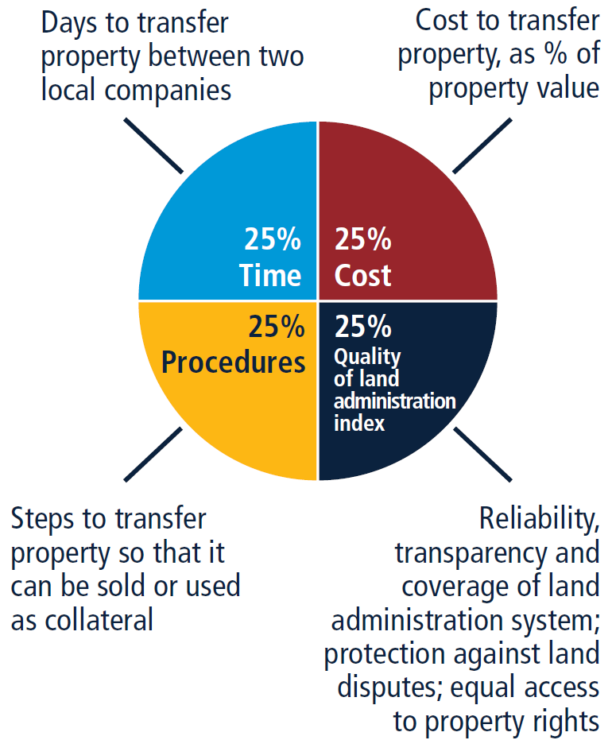
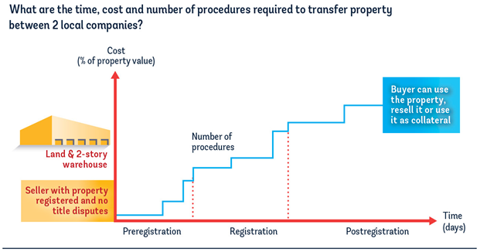
What does Registering Property measure?
  The indicator measures the transfer of a commercial warehouse between two domestic limited liability companies
How is the indicator constructed?
Four sub-indicators

Slide 6
Which procedures to transfer a property are measured and what are the case study assumptions?
All procedures (law and practice)
Starting point: Seller decides to sell and has found the buyer, price already defined.
Case study assumptions
End point: All procedures are completed so that the buyer can use the property, resell it, or use it as collateral. Transaction opposable to third parties.
In the economy’s largest business city (periurban area, within city limits).
About the buyer and seller:
100% domestic limited liability SMEs.
The seller has owned the warehouse for 10 years.
Fixed property value (50xGNI per capita).
Property is registered in the land registry/cadastre and is free of title disputes/mortgages.
Transfer of existing title of land and building – i.e. not initial registration.
About the property:
About the transfer:
Conducting due diligence
(title search, encumbrance checking, cadastral map, checking for unpaid taxes)
Signing of sales and purchase agreement
Payment of stamp duty, transfer tax, and/or registration tax
Registration at the land/property registry

Slide 7
Which aspects of the quality of land administration are measured?
Reliability
Data on reliability assess whether the land registry and mapping system (cadastre) have adequate infrastructure to guarantee high standards and reduce the risk of errors.
Transparency
Data on transparency record whether the land administration system makes land-related information publicly available.
Coverage
Data on coverage assess the extent to which the land registry and mapping system (cadastre) provide complete geographic coverage of privately held land parcels.
Dispute Resolution
Equal Access
Data on dispute resolution measure the accessibility of conflict resolution mechanisms and the extent of liability for entities or agents recording land transactions.
Data measuring whether married or unmarried women have equal access to property rights. Equal access to property rights can help to increase the competitiveness of an economy, or increase its labor force.

Slide 8
Reliability of infrastructure index
Reliable land administration system
Clear information on the ownership
Security of tenure
Development of a land market
Questions on reliability focus mainly on:
The format in which records of property rights (titles, maps) are stored;
Whether this information is electronically available;
How databases for land ownership and cadastral maps are linked.
The maximum score on the reliability of infrastructure index is 8 points.

Slide 9
Reliability of infrastructure index
Questions
How are land titles kept at the registry of the largest business city of the economy? (2-0) Fully digital (2); Scanned (1) or Paper format (0)
Is there is an electronic database to check for encumbrances? (1-0) Yes (1) or No (0)
How are maps of land plots kept at the mapping agency of the largest business city of the economy? (2-0) Fully digital (2); Scanned (1) or Paper format (0)
Is there an electronic database for recording boundaries, checking plans and providing cadastral information — such as a geographic information system? (1-0) Yes (1) or No (0)
How are the land ownership registry and mapping agency linked? (1-0) Single database (1); Linked databases (1) or separate databases (0)
How is immovable property identified? (1-0) Unique (1) or multiple identifiers (0)

Slide 10
Transparency of information index
Transparency is a key element in the quality of land administration systems:
      It helps eliminate asymmetries of information between users and officials;
      It increases the efficiency of the land market.
A transparent land administration system —one in which all land-related information is publicly available, all procedures and property transactions are clear, and information on fees for public services is easy to access— minimizes the possibilities for informal payments and abuses of the system.
The maximum score on the transparency of information index is 6 points.

Slide 11
Transparency of information index
Questions
Is the information on land ownership made publicly available? (1-0) Accessible (1) or Restricted (0)
Is the list of documents required for completing any type of property transaction made publicly available? (0.5-0) Online/public board (0.5) or Not available/obtained only in person (0)
Is the fee schedule for completing any type of property transaction made publicly available? (0.5-0) Online/public board/free of charge (0.5) or Not available/obtained only in person (0)
Does the immovable property registration agency commit to delivering a legally binding document that proves property ownership within a specific time frame? (0.5-0) Online/public board (0.5) or Not available/only in person (0)
Is there a specific and independent mechanism for filing complaints about a problem that occurred at the immovable property registration agency? (1-0) Specific and separate mechanism (1) or General mechanism/no mechanism (0)
Are the official statistics tracking the number of transactions at the immovable property registration agency made publicly available? (0.5-0) Published (0.5) or Not publicly available (0)
Are maps of land plots made publicly available? (0.5-0) Accessible (0.5) or Restricted (0)
Is the fee schedule for accessing maps of land plots made publicly available? (0.5-0) Online/public board (0.5) or Not available/only in person (0)
Does the mapping agency (Cadastre) commit to delivering an updated map of the land plot within a specific time frame? (0.5-0) Online/public board (0.5) or Not available/only in person (0)
Is there a specific and independent mechanism for filing complaints about a problem that occurred at the mapping agency (Cadastre)? (0.5-0) Separate mechanism (0.5) or General mechanism/no mechanism (0)

Slide 12
Geographic coverage index
The usefulness of even the most reliable and transparent land administration system will be undermined if it covers only a limited area of the economy. Where land registries do not provide complete geographic coverage, companies and individuals cannot be sure whether the areas not covered at the registry might be relevant to their interests.
For maximum effectiveness, the registry and cadaster should make records of all registered private land readily available and the records should cover the entire economy.
The maximum score on the geographic coverage index is 8 points.

Slide 13
Geographic coverage index
Questions
How complete the coverage of the land registry is at the level of the largest business city? (2-0) Formally registered (2) or Not registered (0)
How complete the coverage of the land registry is at the economy level? (2-0) Formally registered (2) or Not registered (0)
How complete the coverage of the mapping agency (Cadastre) is at the level of the largest business city? (2-0) Mapped (2) or Not mapped (0)
How complete the coverage of the mapping agency is at the economy level? (2-0) Mapped (2) or Not mapped (0)

Slide 14
Land dispute resolution index
To prevent land disputes and better manage existing ones, the legal framework for land administration needs to assign clear responsibilities to stakeholders involved in land transactions and provide effective mechanisms of dispute resolution that can be implemented in a consistent way and are accessible to all.
The maximum score on the land dispute resolution index is 8 points.

Slide 15
Land dispute resolution index
Questions
Does the law require that all property sale transactions must be registered at the immovable property registry to make them opposable to third parties? (1.5-0) Yes (1.5) or No (0)
Is the system of immovable property registration subject to a state or private guarantee? (0.5-0) Required by law (0.5) or Not required (0)
Is there a specific compensation mechanism in place to cover for losses incurred by parties who engaged in good faith in a property transaction based on erroneous information certified by the immovable property registry? (0.5-0) Yes (0.5) or No (0)
Does the legal system require a control of legality of the documents necessary for a property transaction (e.g. checking the compliance of contracts with law requirements)? (0.5-0) Review of legal validity (0.5) or No review (0)
Does the legal system require a verification of the identities who are parties to a property transaction? (0.5-0) Verification (0.5) or No verification (0)
Is there a national database to verify the accuracy of identity documents? (1-0) Available (1) or Not available (0)
How long does it take on average to obtain a decision from the first instance court for such a case (without appeal)? (3-0) Less than 1 year (3); Between 1 and 2 years (2); Between 2 and 3 years (1) or more than 3 years (0)
Are there any annual statistics on the number of land disputes in the first instance? (0.5-0) Published (0.5) Not publicly available (0)

Slide 16
Equal access to property rights index
Equal access to property rights is important given that around half of the world’s population is female.
Equal access to property rights allows to integrate women more rapidly into the workforce, and facilitates women to become entrepreneurs. For instance, property can be used to access finance.
Restrictions on equal access to property rights are measured by subtracting points in the quality of the land administration score.
Questions
Do unmarried men and unmarried women have equal ownership rights to property? (-1-0) Unequal rights (-1) or Equality (0)
Do married men and married women have equal ownership rights to property? (-1-0) Unequal rights (-1) or Equality (0)

Slide 17
Why does it matter?
What does it measure – and what does it not?
What are the main findings in DB19?
Results for Azerbaijan in DB19

Slide 18










Where is Registering Property easiest in 2017/18?
Procedures (number) | Time (days) | Cost (% of property value) | Quality of land administration index (0-30)
2 | 1 | 0.1 | 26.5
3 | 7 | 0.1 | 28.5
3 | 3.5 | 0.8 | 28.5
1 | 1 | 0.0 | 21.5
2 | 3 | 0.0 | 23.5
3 | 17.5 | 0.5 | 27.5
2 | 1.5 | 0.2 | 22.0
3 | 3.5 | 0.2 | 24.0
3 | 16.5 | 0.0 | 25.5
1 | 7 | 4.3 | 27.5
Top ten performers Score
1. New Zealand 94.89
2. Rwanda 93.70
3. Lithuania 92.96
4. Georgia 92.86
5. Belarus 92.19
6. Estonia 91.02
7. United Arab Emirates 90.88
8. Kyrgyz Republic 90.27
9. Slovak Republic 90.17
10. Sweden 90.11
Source: Doing Business 2019.

Slide 19
28 economies made it easier for businesses to register property in 2017/18
Reform | Economies | Some highlights
Increased reliability of infrastructure | Croatia; Djibouti; Pakistan; Sri Lanka; Togo | Croatia became fully digitized, increasing the efficiency and transparency of services provided by the Land Registry and Cadaster. Sri Lanka worked toward implementing a fully digital Land Registry and Survey Department by rolling out a geographic information system (GIS) and creating a Single Window Counter (SWC) for the issuance of certificates
Increased transparency of information | Azerbaijan; Croatia; Eswatini; Gabon; Indonesia; Israel; Mauritius; Pakistan; Papua New Guinea; Rwanda; Togo; Tunisia; United Arab Emirates; West Bank and Gaza | Gabon and Israel upgraded their official websites to include relevant information to the public at large regarding land registry services. Pakistan and West Bank and Gaza began publishing online official statistics tracking the number of transactions at the immovable property registration agency.
Reduced taxes or fees | Chad; China; Congo, Dem. Rep.; Congo, Rep.; Djibouti; Guinea; Togo | Congo, Dem. Rep. reduced the cost of securing land and property titles. Guinea reduced the fees to transfer property from 2% to 1.2% of the property value.
Reduced time | Djibouti; France; Kenya; Malawi; Malaysia; Morocco; Sri Lanka; Togo; West Bank and Gaza | Malawi made property transfer faster by decentralizing the consent to transfer property to local government authorities.
Increased administrative efficiency | China; Djibouti; Indonesia; Israel; Kenya; Morocco; Niger; Pakistan; Senegal; Sri Lanka; Togo | Niger improved communication between the taxation department and the registration department by merging procedures, making reviewing and approving property transfers significantly faster. Senegal further streamlined the interactions between different departments at the Property Registry (Conservation Foncière).
Source: Doing Business 2019.

Slide 20
Why does it matter?
What does it measure – and what does it not?
What are the main findings in DB19?
Results for Azerbaijan in DB19

Slide 21
Registering property in Azerbaijan –score
FRONTIER
Azerbaijan scored 84.63 points in DB score of Registering Property in Doing Business 2019, giving it a ranking of 17th in the indicator.
Source: Doing Business 2019

Slide 22
Registering property in Azerbaijan
What are the procedures?
Verification of title and obtaining non-encumbrance certificate (.5 days, online)
Notarization of sale-purchase agreement (1 day)
The buyer obtains the updated title (4 days)

Slide 23
Azerbaijan – Reforms in DB19
Azerbaijan- DB19 Reforms:
1. During the second half of 2017, the State Committee upgraded their website (http://emdk.gov.az/index.php/en/2014-01-18-10-59-29/2014-05-08-07-59-18/registration) to publish statistics on the number of property transactions for the largest business city as well as the entire country.
2. At the same time, the Ministry of Justice upgraded their website (http://justice.gov.az/?view=statistic&post_id=4) to publish statistics on the number of land disputes in the First Instance Court. In doing so, the Republic of Azerbaijan increased their score on the quality of land administration index by improving their transparency on the land dispute resolution index.

Slide 24
Registering property in selected economies

Slide 25
THANK YOU!

